Slide 1
Twitter
Sentiment Analysis
Assignment 3: Zhengzheng Wang

Slide 2
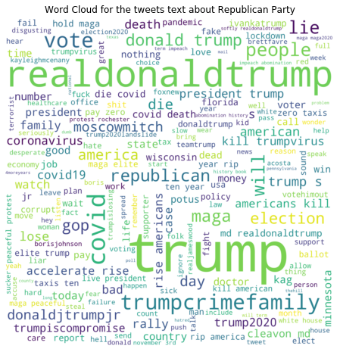
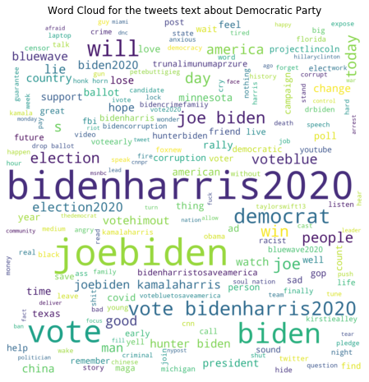
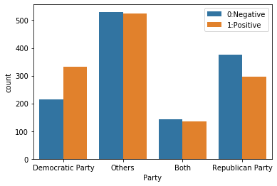
Exploratory Analysis
US_Election_2020 Dataset
Distribution of sentiment for different political affiliations
From the left plot of sentiment distribution for different political parties, we can see for Republican Party, there are much more negative tweets than positive ones. And for Democratic Party, the number of positive tweets is much higher than that of negative ones.
From the word cloud for different political parties, for Republican Party(middle), many negative words have bigger size which means they appear frequently on twitter. While for Democratic Party(right), there are many obvious positive words such as 'love','good','win','support' and so on.

Slide 3
Model Preparation & Implementation
01
03
02
04
Model Preparation
Model Evaluation
Text Vectorization: BoW & TF-IDF
Split Data into Training Data and Test Data
Apply the best model to US election data
The accuracy is 97.8056%
Model fits well
Model Training
Sentiment Prediction vs. True Sentiment Visualization
Use 7 Models
The best model with highest test accuracy is logistic regression
Confusion Matrix
Bar Plot for Different Political Parties

Slide 4
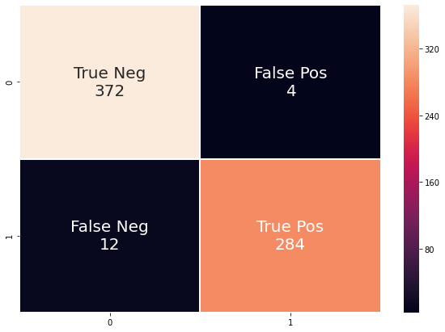
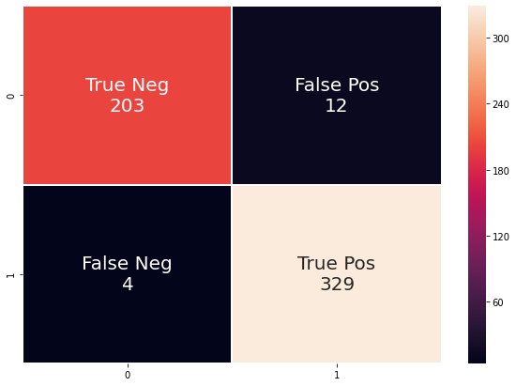
True Sentiment VS. Predicted Sentiment
Confusion Matrix for Republican Party only
Confusion Matrix for Democratic Party only
For Republican Party, there are 4 False Positive and 12 False Negative.
For Democratic Party, there are 12 False Positive and 4 False Negative.
Most of the data is correctly predicted

Slide 5
Negative Reason Prediction
01
03
02
Negative Reasons
Visualization of Prediction Result
covid19,discrimination, corruption,crime, others
Hyperparameter Tuning
Random Forest Prediction on Test Dataset
The test accuracy of best model is 38.68%
Visualize the difference between true reason and predicted negative reason
10-fold Cross-Validation and Grid Search
The best model with highest test accuracy is random forest (max_depth=200, min_samples_split=10)

Slide 6
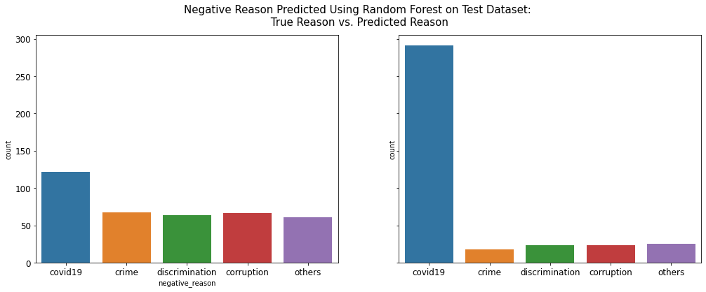
The test accuracy is not high, may be due to the reason that the size of the dataset is too for multi-classification problem
The reason ‘covid19’ accounts for the biggest part, while the number of any other reason is even less than 100.
To improve the accuracy, we had better collect more data.
“

